Slide 1
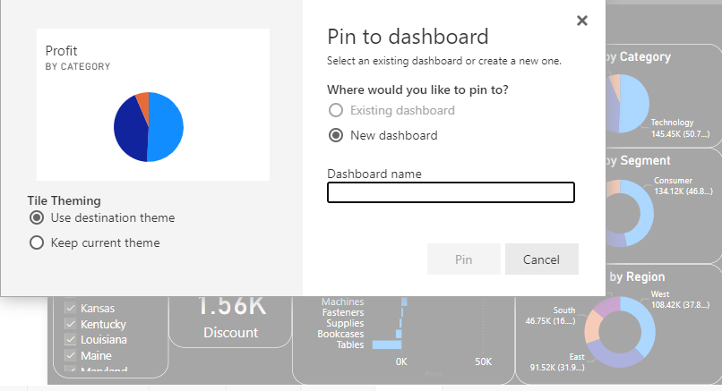

Dashboard in Power BI
In Power Bi dashboard can be created only in Power BI Service. To ad a visual you just need to pin the Visual to the dashboard.
Dashboard can also be created through My workplace.

Slide 2
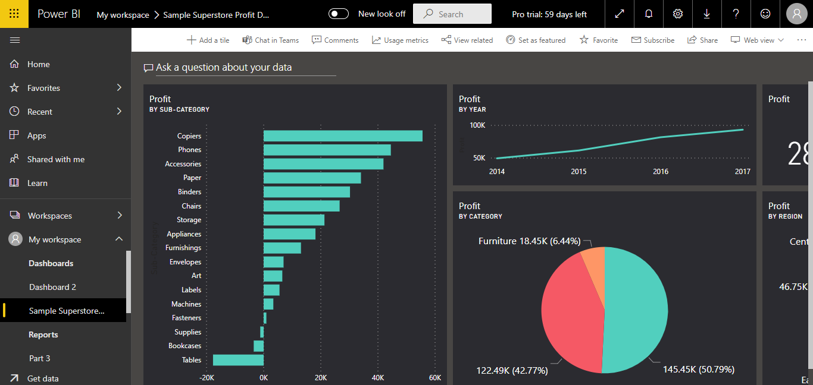
Dashboard in Power BI
PowerBi Dashboard are not interactive by default. To make the dashboard interactive you need to pin the live page.
These are actually useful if you want to see the static view.

Slide 3
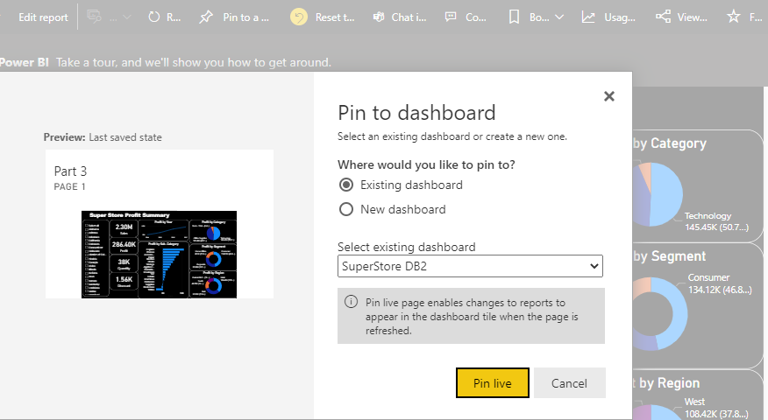
Dashboard in Power BI
Power Bi dashboards are not interactive by default.
To make the dashboard interactive you need to pin the live page.
In the real time scenario Reports are majorly used.
These are actually useful if you want to see the static view.

Slide 4
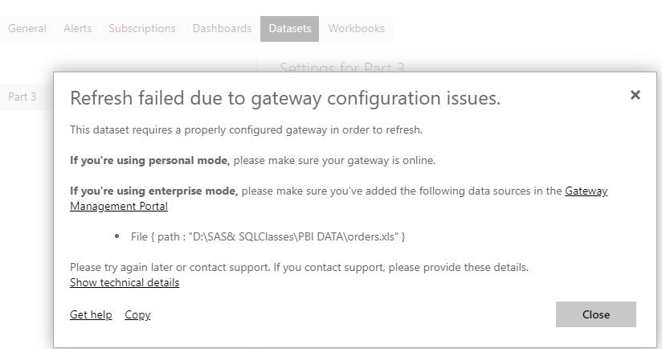
Refreshing Data in Power BI
To refresh the data you need to go to : My workspace ->Datasets -> Refresh

Slide 5
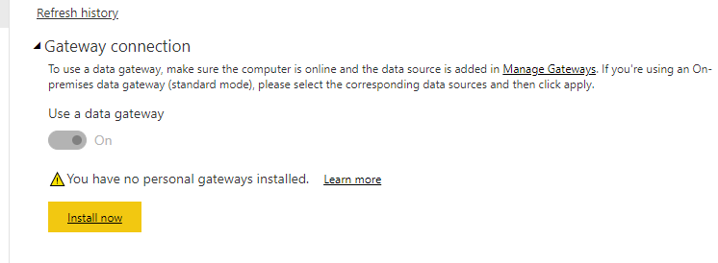
Refreshing Data in Power BI
The Refresh failed message is displayed as the Data Gateway is not configured. To resolve this : Download & Install Data Gateway.
Refresh the dataset
Check for Username & password under
My workspace ->Datasets -> Settings -> Data Source Credentials
Scheduled refresh (8 Schedules in Pro & 48 in Premium Account)

Slide 6
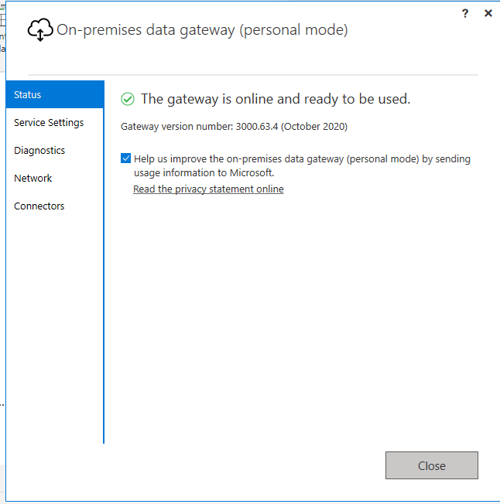
Refreshing Data in Power BI
Once the Gateway is installed and configured successfully, below confirmation will be displayed.
Refresh the dataset
Check for Username & password under
My workspace ->Datasets -> Settings -> Data Source Credentials
Scheduled refresh (8 Schedules in Pro & 48 in Premium Account)

Slide 7
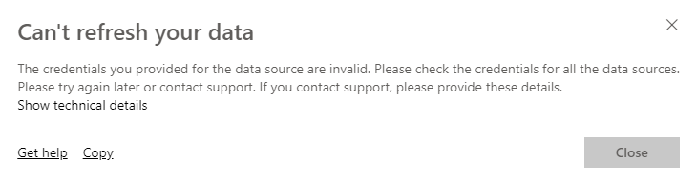
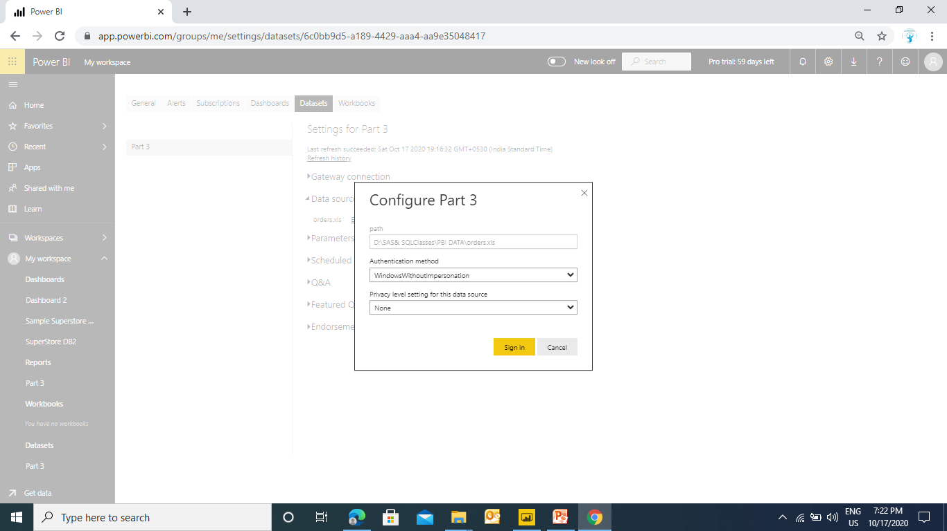
Refreshing Data in Power BI
Now try to refresh the Dataset. You may be prompted with the below message.
To resolve this you need to specify the Data source credentials
Refresh the dataset
Check for Username & password under
My workspace ->Datasets -> Settings -> Data Source Credentials
Scheduled refresh (8 Schedules in Pro & 48 in Premium Account)

Slide 8
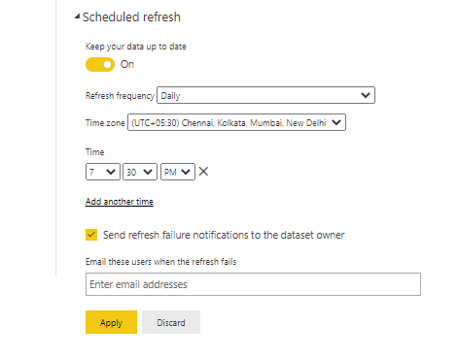
Scheduled Refresh in Power BI
You can automate the refresh by scheduling a refresh.
Turn on the Scheduled Refresh
Specify the frequency (Daily / Weekly)
Set the time
Specify a refresh failure email recipient
Apply
Refresh the dataset
Check for Username & password under
My workspace ->Datasets -> Settings -> Data Source Credentials
Scheduled refresh (8 Schedules in Pro & 48 in Premium Account)
Note : Refresh can be done 8 times a day in Pro Account
In Premium account it can be done 48 times

Slide 9


Visualize the data in any meaningful way to help the institute to analyse the data.
Design a report for the planning data based on country, institute, department, year, quarter, and qualification.
KPI
No of Students per Country
No of Students per Institute
No of Students per Department
No of Students per Qualification
Percentage of Withdrawn cases
Time series analysis of active and withdrawn classes

Slide 10

Power Query
A ETL tool

Slide 11
Using Functions in Power Query
Power Query is a ETL tool (Extract Transform Load) which provide many function (Text Functions / Date Functions/ Number Functions)
Merge
Split
Change Case
Extract (left, right, substring, Delimiter)
The best part of Power Query is you do not have to write any formula.
To get the Power Query editor select the data source and click on Transform

Slide 12
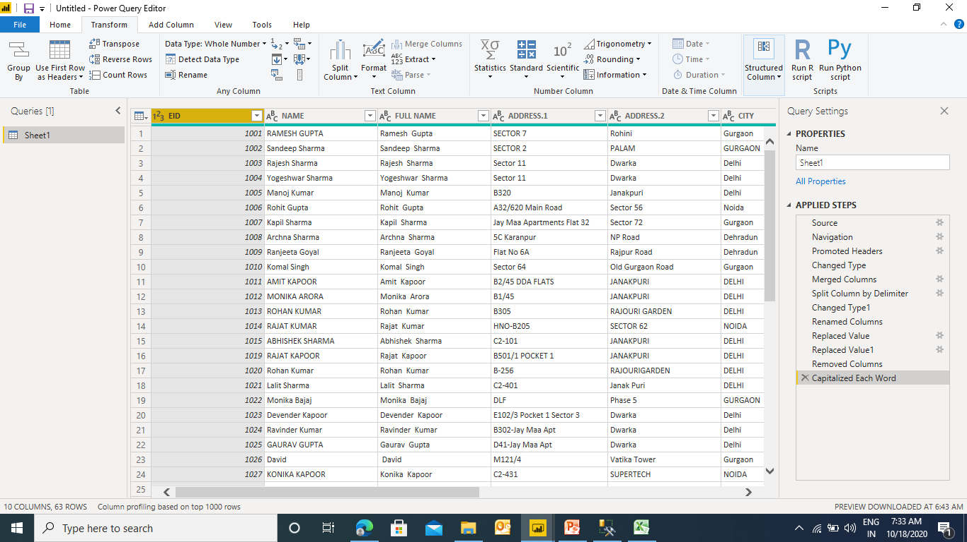
Using Text Functions in Power Query
To get the Power Query editor select the data source and click on Transform

Slide 13
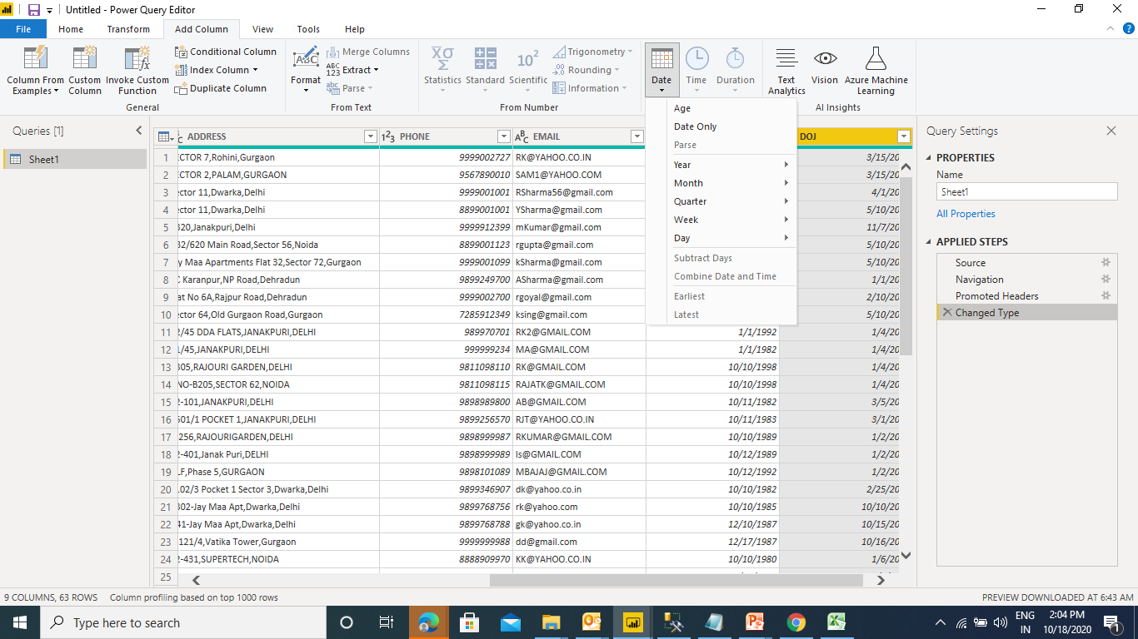
Using Date Functions in Power Query
Date functions like Day, Month Year, Subtract, Day Name, Month Name, calculate Age

Slide 14
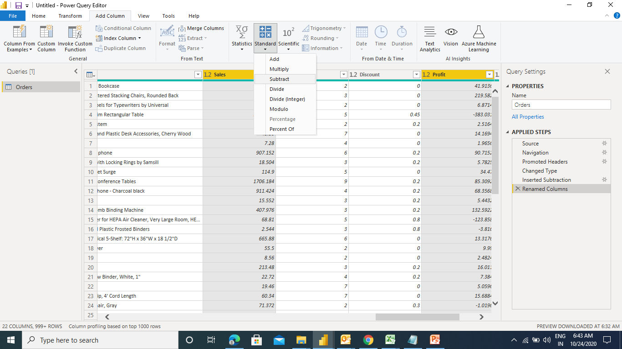
Using Number Functions in Power Query
In Power Query you can use around 32 calculations without writing any formula just simple button clicks. Add, Subtract, Multiply Divide, Percentage, Percentage of, Round, Sign, Is Even, Is Odd

Slide 15
Create a visual to display the average shipping days per state.
Bifurcate the Regional sales count on the basis of profit & loss
Create a visual to display the sales pattern on the basis of week day
Create a employee code containing 1st character of 1st name, 1st character of last name and last 4 digits of EID.
Create a visual to display Monthly Birthday Status of the employees

Slide 16
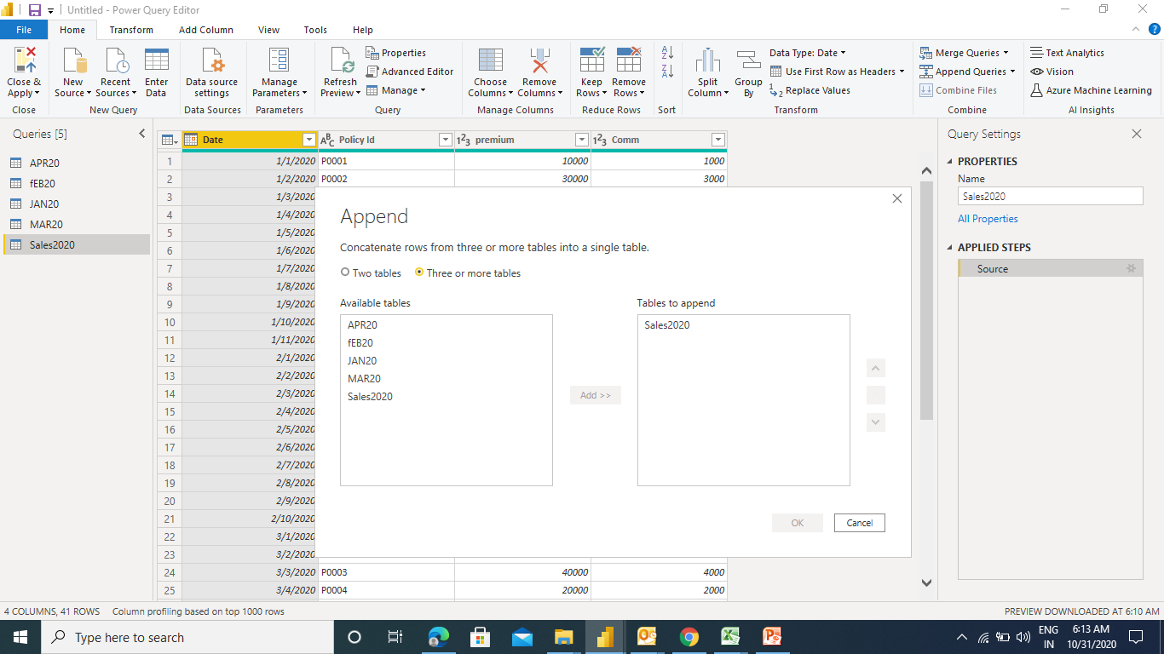
Appending Sheets in Power Query
Multiple sheets in Excel can be appended as a single sheets in Power BI.
Go To Append Queries -> Append Query as New -> Select The sheets to be appended -> Click Add -> Ok
Note: Columns Name should be same.
To display only the appended sheet in Power BI clear the ENABLE LOAD option for other sheets.

Slide 17
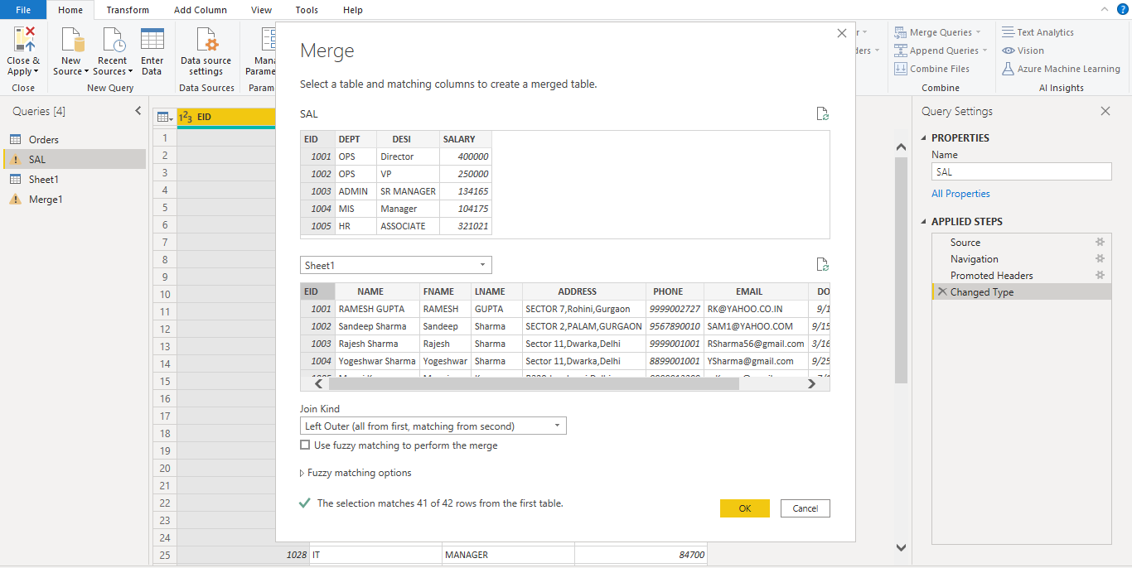
Merging Sheets in Power Query
Merging Sheets in Power Query can be considered as advanced lookup.
Go To Merge Queries -> Select The tables to be merged -> Select the common field ->
Specify the join type - > Ok
Merging Sheets can also be done in multiple data source & Multiple Columns

